Slide 1
AUTO-LABELING OF GITHUB ISSUES FROM GH-ARCHIVE
POD – 4​​
Interns​ Baby Nikhila Gannamani​ Deepthi Mikkilineni​ Shivanvita Jasti​ Sriram Teja Kora
Mentors Prasanth Gudiwada Mingzhe Fang Saumya Pradhan

Slide 2
PROBLEM STATEMENT
The objective of this project is to develop an efficient system for automatically labeling issues from the publicly available GH-Archive dataset. The primary goal is to categorize each issue into one of three distinct classes: Bug, Feature, or Request. By leveraging machine learning techniques, the proposed solution aims to enhance issue management and organization within software development projects on GitHub.
GIT - https://github.com/ShivanvitaApexon/Pod4_Project
DELIVERABLES
Developed a Databricks workflow job for automating ETL, visualization, and logging of Commits Data from GH Archive.
Implemented another Databricks workflow job for automating ETL, visualization, logging, and classification of Issues Data.
Designed a PowerBI dashboard for interactive data visualizations of the Issues data.
TOOLS • Azure Blob Storage • Databricks • Python (Pandas, Plotly) • PySpark • PowerBI • GIT

Slide 3
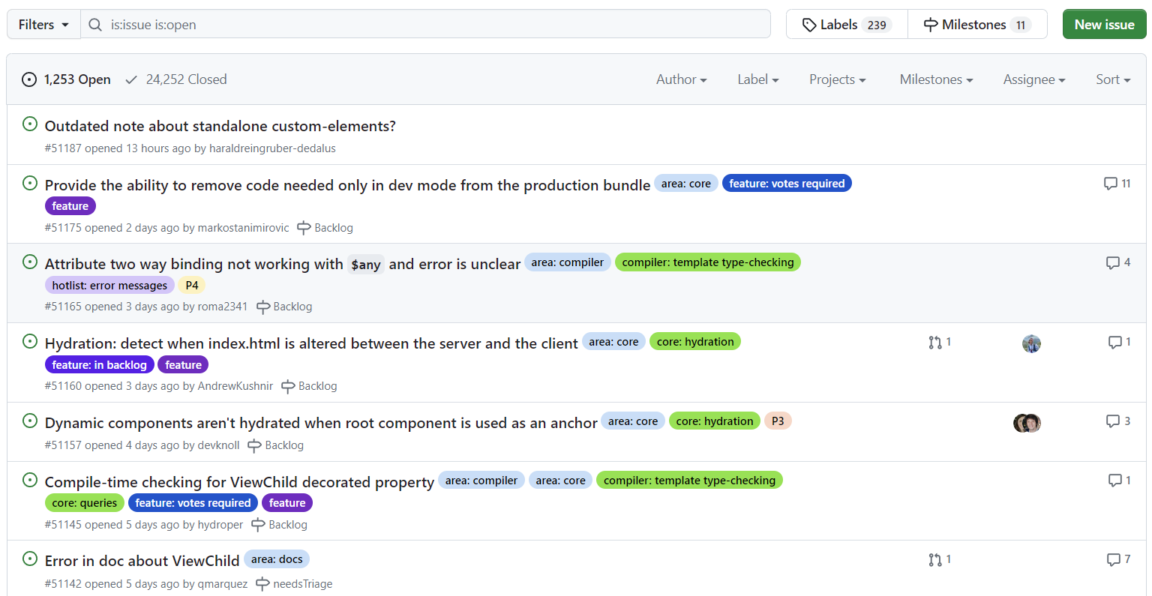
EXAMPLE
This is an example of the issues that are raised in the GIT.

Slide 4
POTENTIAL USE-CASES
Issue Triage
Sort issues based on priority and send it to the right teams quickly and efficiently.
Automatic Replies and Notifications
Instantly respond to user's issues and notify teams for prompt action.
Issue Prioritization
Automatically identify and focus on critical issues to address them promptly.

Slide 5
Table of contents
Solution design
Data introduction
Commits data visualization
Issues data visualization
Issues modelling
Future enhancements

Slide 6

Solution Design

Slide 7
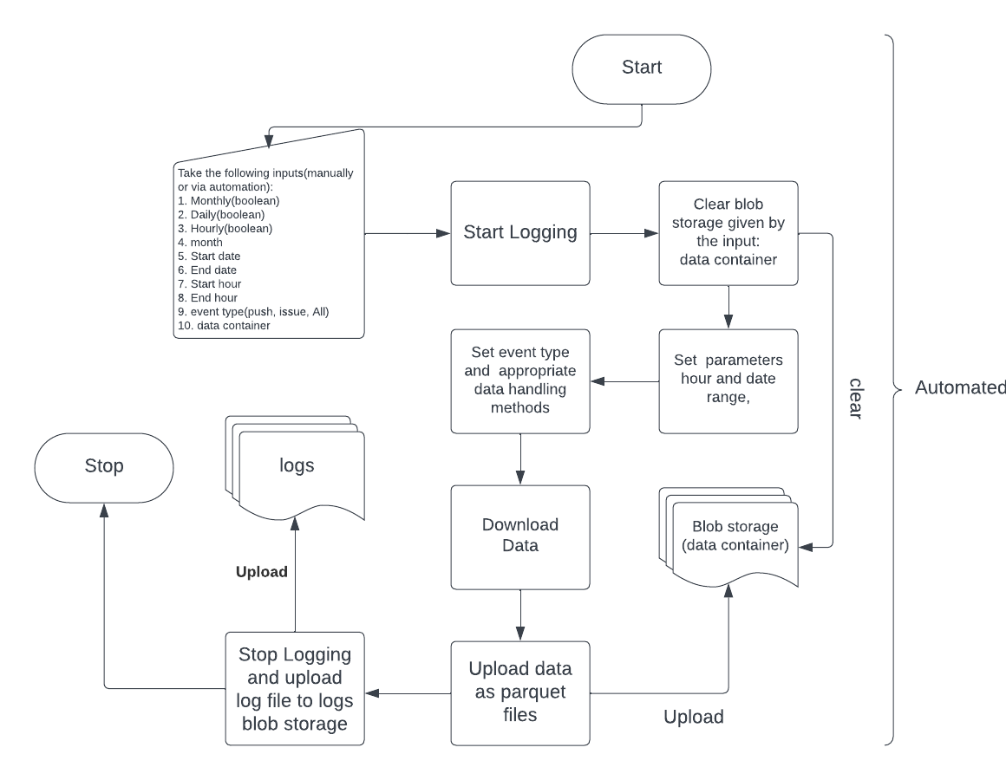
ETL
This system takes input parameters such as data request frequency (hourly, daily, or monthly), start and end dates, start and end times, event type (push, issues, all), and storage container.
It downloads and processes data based on the provided inputs, then uploads the processed data in Parquet file format. Each file contains a maximum of 24 hours' worth of data.
Additionally, the system generates and stores logs in blob storage, categorized at various levels: info, debug, and error.

Slide 8
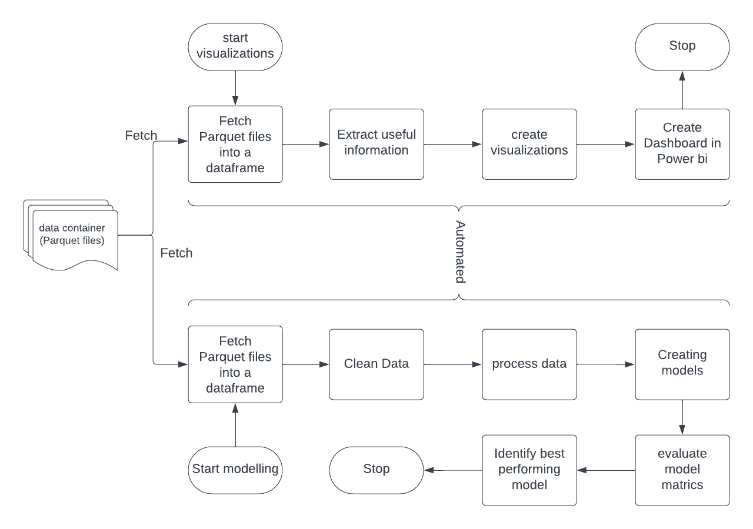
Visualizations and modelling
Data uploaded via ETL process is used for visualization and ML modeling
For visualizations, we process the data to extract useful information for the various visualizations and dashboards
For modeling, we clean and process the data to fit our models
The models trained on this data are evaluated using metrics like AUC-ROC, Precision, Recall, and Accuracy

Slide 9

Data introduction

Slide 10
Introducing GH–Archive data
GH Archive is a project to record the public GitHub timeline, archive it, and make it easily accessible for further analysis.
GitHub provides 15+ event types, which range from new commits and fork events, to opening new tickets, commenting, and adding members to a project
These events are aggregated into hourly archives, which you can access with any HTTP client

Slide 11
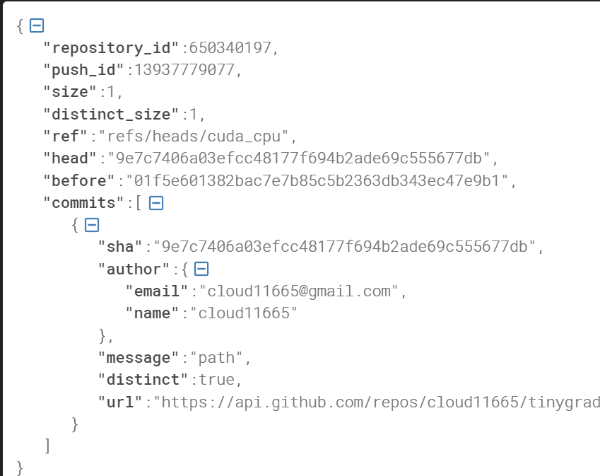
Commits data
Push Event -
type | repo | payload | public | actor | Created_at | org
PushEvent | {'id': 525208115, 'name': 'B74LABgit/HOBO', 'u... | {'repository_id': 525208115, 'push_id': 139377... | True | {'id': 111329684, 'login': 'B74LABgit', 'displ... | 11 2023-06-10 15:00:00+00:00 | NaN
The commits data used in this project is extracted from Push events found in GH-Archives.
Considering that every commit is made using a Push command, analyzing push events provides a comprehensive overview of the commit data
We downloaded and visualized one month's worth of commit data for analysis.
Push Event Payload-

Slide 12
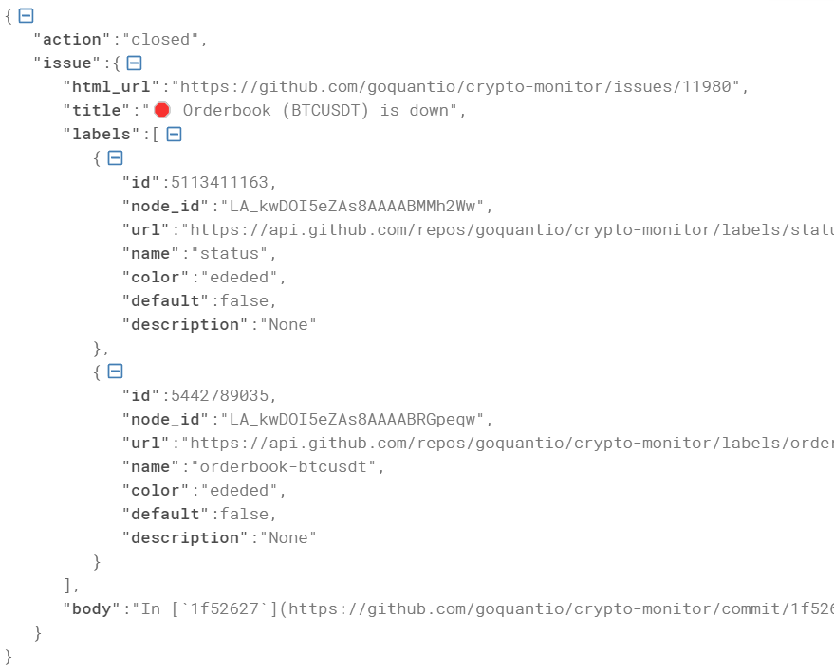
ISSUES DATA
Issues Event -
type | repo | payload | public | actor | Created_at | org
IssuesEvent | {'id': 461921808, 'name': 'Ogu1208/Ogu1208', '... | {'action': 'opened', 'issue': {'url': 'https:/... | True | {'id': 76902448, 'login': 'Ogu1208', 'display.. | 11 2023-06-10 15:00:00+00:00 | NaN
Issues data was extracted from Issues Event of Gh archives.
It consists of columns repo, html_url, title, body, labels, and target and has dimensions of 56,422 records and 6 columns.
The text columns were cleaned using clear text package after removing any special characters or symbols.
Issues
Event Payload

Slide 13

Commits data visualizations

Slide 14
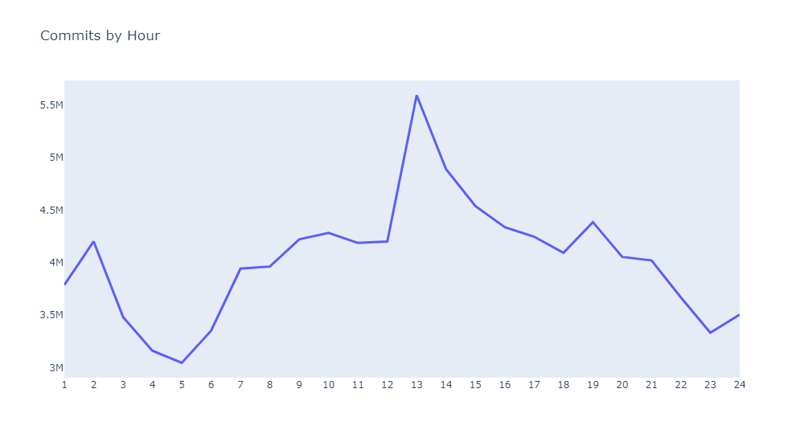
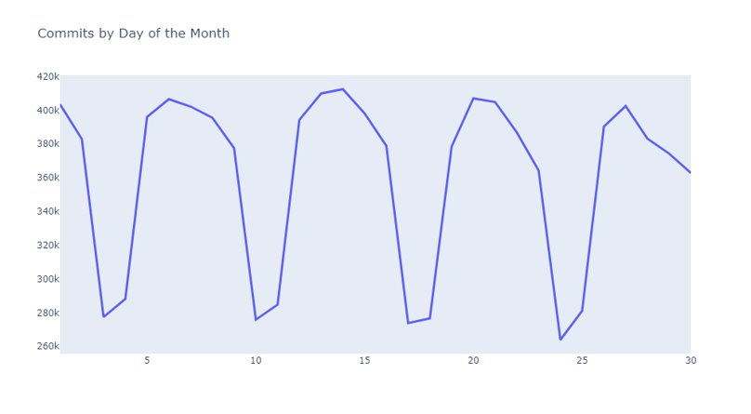
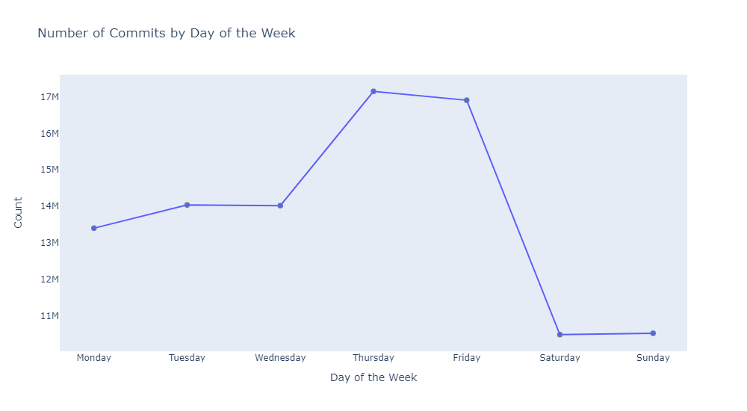
Most Commits are done around 1 pm
There's a weekly seasonality in the commits
Most Commits are done on Thursdays and Fridays

Slide 15
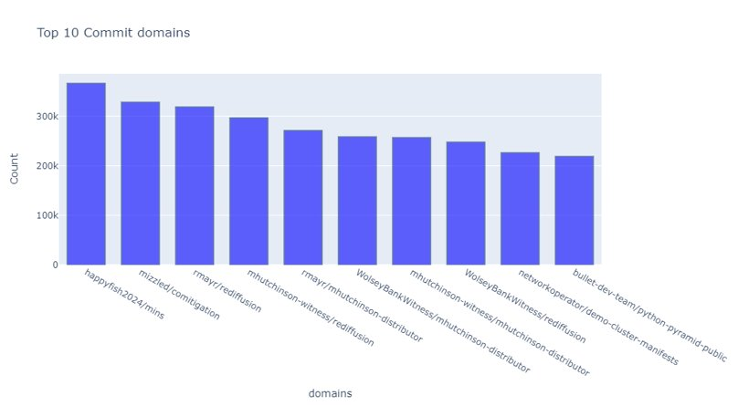
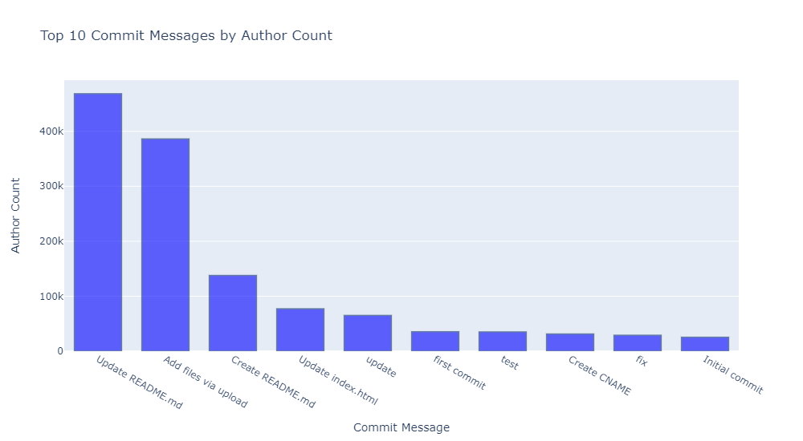
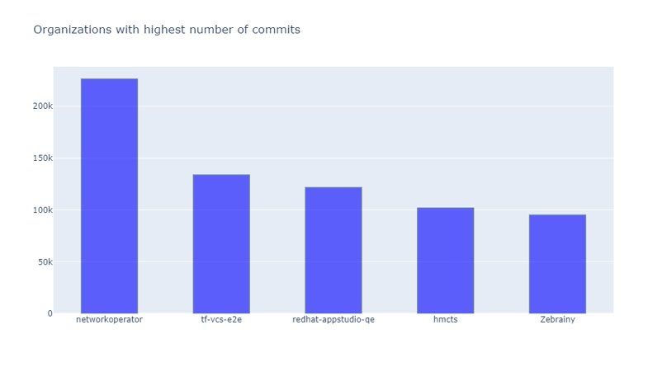
"Update READ.me" is the most common title given by various authors followed by "Add files via uploads". Upon further analysis we found that these could be auto generated commit titles given by git

Slide 16

Issues data visualizations

Slide 17
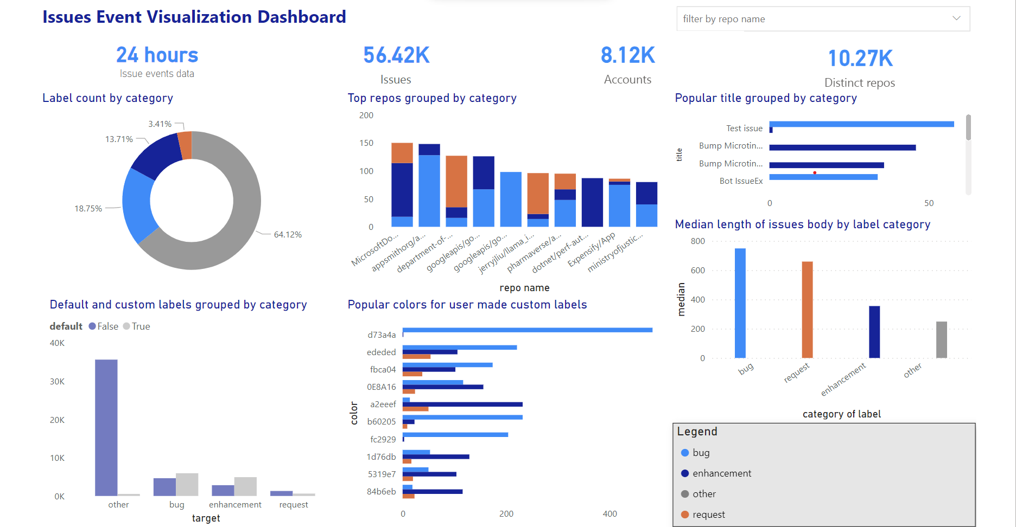

Slide 18
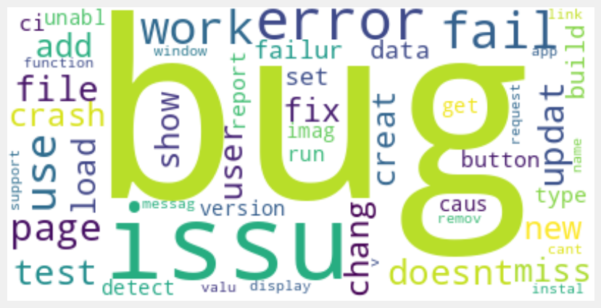
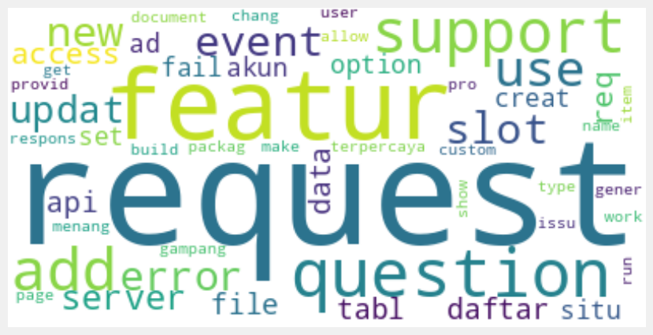
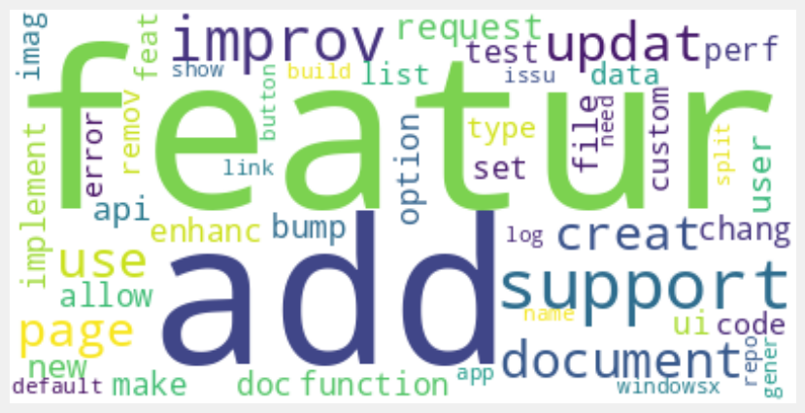
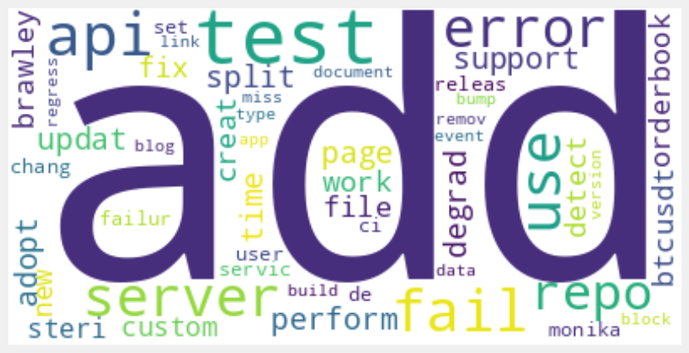
WORDCLOUD
BUG
REQUEST
Bug
Issue
Error
Work
Fail
Change
Request
Feature
Question
Support
Event
Use
FEATURE
OTHER
Feature
Add
Support
Document
Improve
Create
Add
Test
Error
Api
Fail
Server

Slide 19

Issues modelling

Slide 20
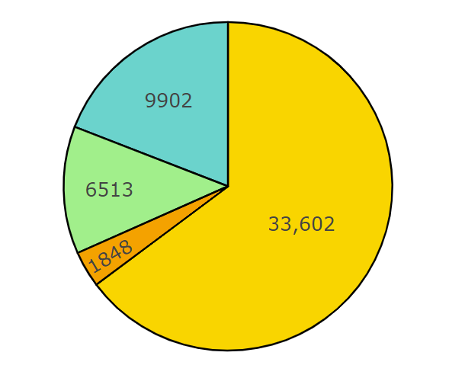
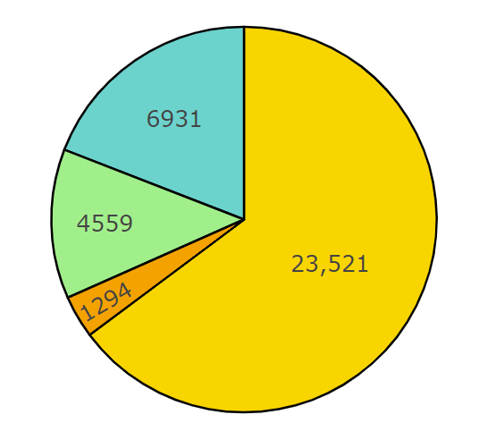
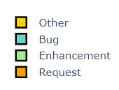
DATA PREPARATION
Employed stratified sampling to split the data into test and train sets.
Before split After split
Transformed the textual features into vectors using TF-IDF vectorization.

Slide 21
MODELING
Classification models used – SVM, Naïve Bayes, Random Forest
Why opt for these models?
Naïve Bayes is a simple and easy-to-understand algorithm.
Uses Bayes' theorem and assumes feature independence.
Computationally efficient and straightforward to implement.
Support Vector Machine is effective and performs well in multi-class classification tasks.
Handles non-linear relationships effectively.
Random Forest builds multiple decision tree models and combines predictions through voting.
Results in improved accuracy and robustness in classification and regression tasks.
Not prone to overfitting and considered reliable.

Slide 22
Model Accuracies
Features | Model | Accuracy
Title | Random Forest | 72
 | Naïve Bayes | 72.56
 | SVM | 73.68
Body | Random Forest | 72
 | Naïve Bayes | 65.5
 | SVM | 73.2
Title & Body | Random Forest | 73.9

Slide 23
WHY AUC-ROC ?
Imbalanced dataset – accuracy can be misleading, by predicting the majority class all the time (other).
AUC-ROC provides a summary of the model's overall performance across all classes.
It aggregates the class-wise performance into a single scalar value, simplifying the comparison of different models.

Slide 24
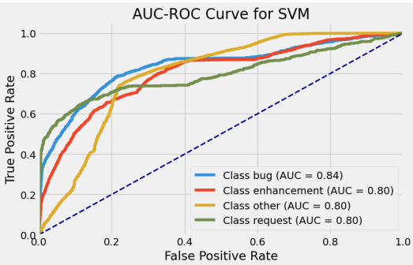
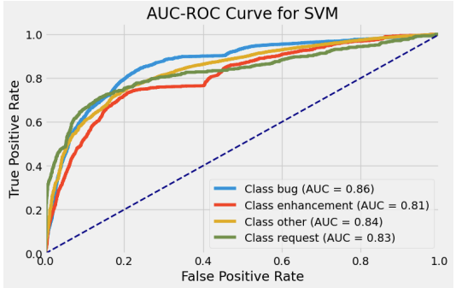
SVM Results
Title Body
From the above plots, it can be inferred that the SVM model with body as the feature performed better than that of title as the feature.

Slide 25
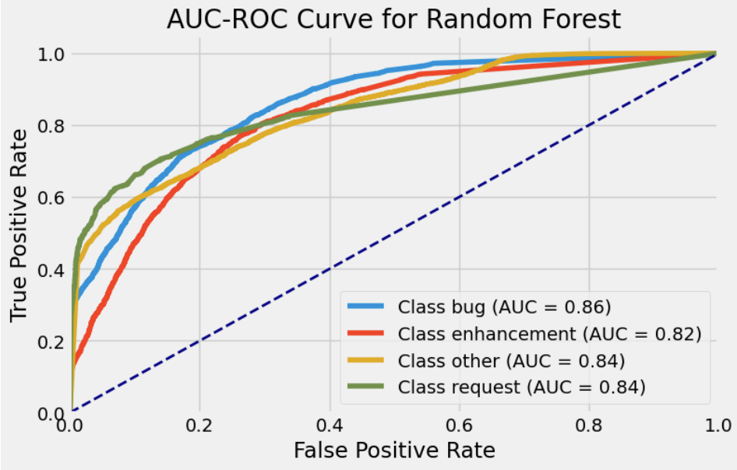
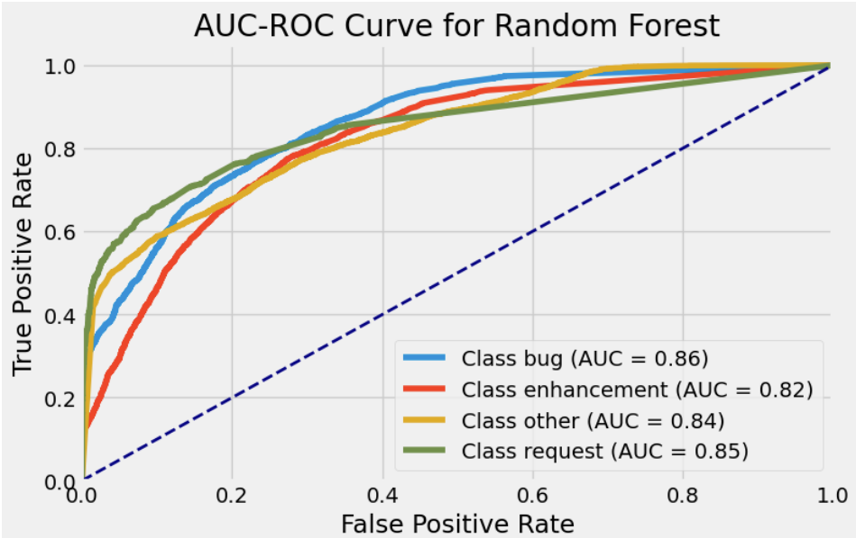
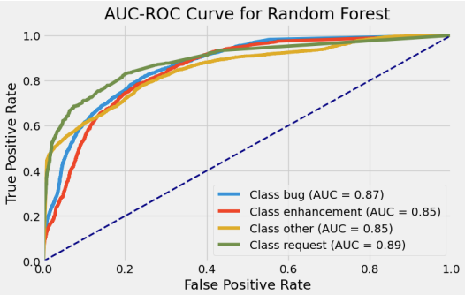
Title Body Title & Body
Random Forest Results
From the above plots, it is evident that the model with two features – Title and Body, yielded better results with a strong ability to distinguish between the classes.

Slide 26
CONCLUSION
The project successfully achieved its objective by developing an efficient system for automatically labeling issues, improving issue management within GitHub projects.
As there is a dependency between classes, the Naive Bayes model did not perform as well as expected.
Among the tested models, Random Forest with both the body and title as features exhibited the best performance for issue classification, outperforming SVM and Naive Bayes.

Slide 27
FUTURE ENHANCEMENTS
Complete Automation from downloading to Power BI visualizations to model creation and selection.
Logging utilizing logging mechanisms provided by Azure.
Create APIs to provide real time issue label predictions.
Automated model monitoring to check for model or data degradation.

Slide 28
REFERENCES
Git Repo
GH-Archives website
ETL Notebook
Commits Visualizations Notebook
Issues Visualizations Notebook
Modeling Notebook

Slide 29
QUESTIONS?

Slide 30
THANK YOU

